Slide 1


A Containerized RAG Architecture for Efficient Document Retrieval using BGE Embledings and Qdrant
Final Project - Professional Training YN3012170034
ROY SUDIPTA
20243120070

Slide 2

System
Architecture
Frontend
Backend
Vector Database
ML Model
Streamlit UI
FastAPI
Qdrant
BGE Large v1.5
Data Flow:
Upload Flow: User → Streamlit UI → FastAPI → PDF Processing → Chunking → Embedding → Qdrant
Query Flow: User Query → Streamlit UI → FastAPI → Embedding → Qdrant Search → Results → UI

Slide 3

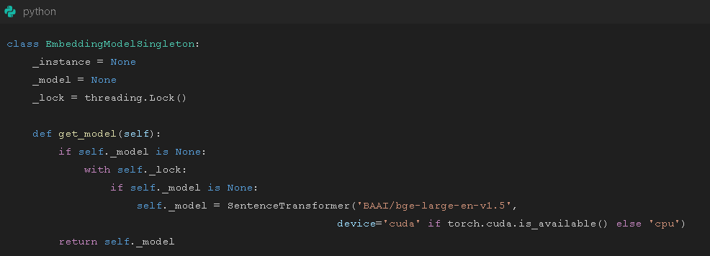
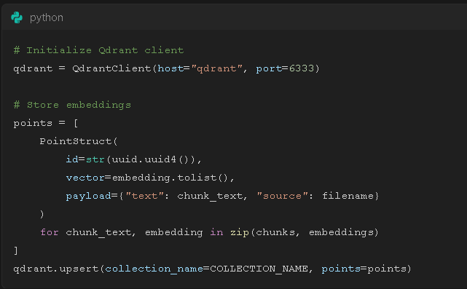
Major Code snippets
Technical Implementation - Backend
showing the embedding service:
  We implemented a thread-safe singleton pattern for our embedding model to ensure efficient memory usage.
  The model automatically detects and uses GPU if available, falling back to CPU otherwise."
  We're using the BGE (BAAI General Embedding) model which provides state-of-the-art performance for retrieval tasks."
Vector Database Integration
Code for Qdrant operations:
  Qdrant provides efficient vector similarity search with support for filtering and metadata storage.
  We store both the vector embeddings and their corresponding text chunks with metadata about the source document.
  The system can handle multiple document uploads while maintaining document-level isolation where needed.

Slide 4
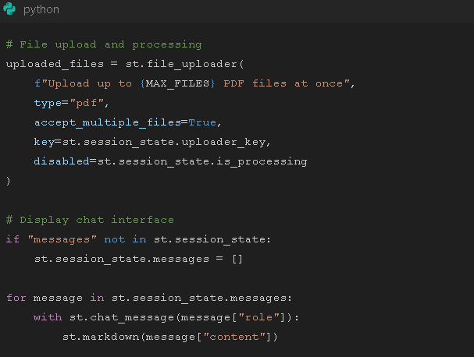
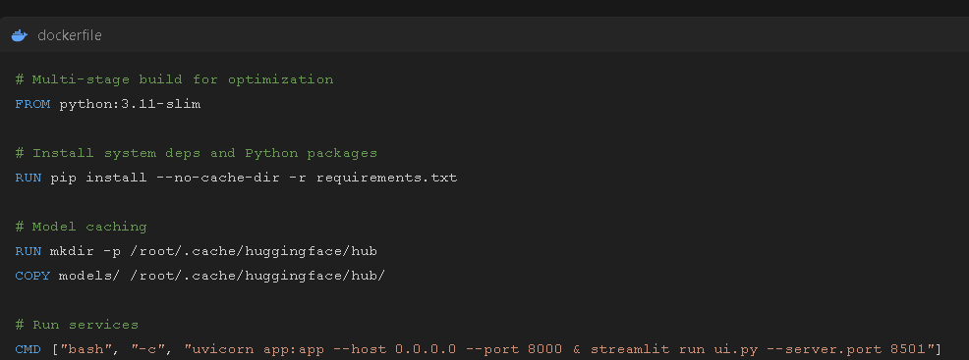
Major Code snippets
Frontend Implementation
Streamlit UI code snippet:
  "The Streamlit interface provides a clean, interactive way for users to upload documents and ask questions."
  "We maintain conversation history in the session state for a better user experience."
  "The UI includes features like file upload limits, processing indicators, and error handling."
Dockerfile highlights:
Dockerfile highlights:
  "Our Docker setup includes several optimizations for production use."
  "We use a multi-stage build to keep the final image size small."
  "The model is pre-downloaded and cached to speed up container startup."
  "Both FastAPI and Streamlit services run in a single container for simplicity, though they could be split for better scalability."

Slide 5

Performance & Results
I’ve also implemented efficient text chunking and batching to handle large documents
01
Performance metrics:
02
Example use cases:
  Average query latency: <500ms
  Support for documents up to 100 pages
  Scalable to thousands of documents
  Document Q&A
  Semantic search
  Content summarization

Slide 6
THANK YOU

